Slide 1

Optimizing the job application process with priority-based scheduling

Slide 2


Introduction
In the dynamic landscape of job hunting, where opportunities abound and time is of the essence, the need for a streamlined and efficient job application process has never been more paramount. The project represents a dedicated endeavor to enhance this intricate journey by introducing a priority-based scheduling approach.
Finding your way in the Job Jungle!
Beyond efficiency, this project is about elevating the entire job search experience.
It's designed to turn the usual job application routine into a personalized journey, ensuring that applicants not only find the right opportunities but also enjoy the ride along the way.

Slide 3




The team!
Aswin Chander Aravind Kumar
Indhuja Muthu Kumar
Keerthana Velilani

Slide 4

Defining the problem
How to efficiently prioritize and schedule job applications based on job type, user preferences, and deadlines ?

Slide 5

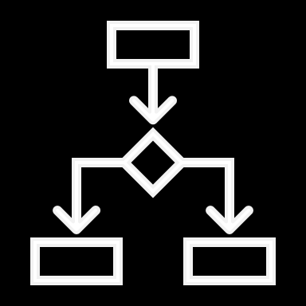




Implementation
The job application optimization system utilizes a weighted scoring algorithm to consider factors such as deadline, preference, skills to determine priority of each application. Applications are efficiently sorted based on calculated priorities, and a scheduling algorithm handles deadlines and conflicts. Visualizations show scheduled applications on a timeline plot and a pie chart for applications scheduled by job type.
Key Takeaways
Weighted scoring algorithm for calculating application priorities.
Applications are sorted based on calculated priorities.
Scheduling prioritized applications and handling conflicts.
Applicant Preferences
Employed priority queues to calculate the priority of job applications.
Deadlines
Skills match
Experience
Company reputation

Slide 6

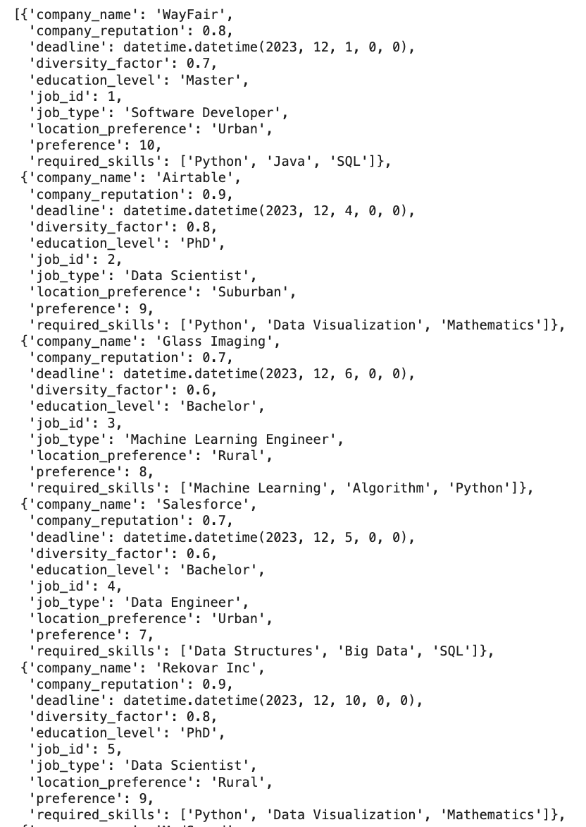
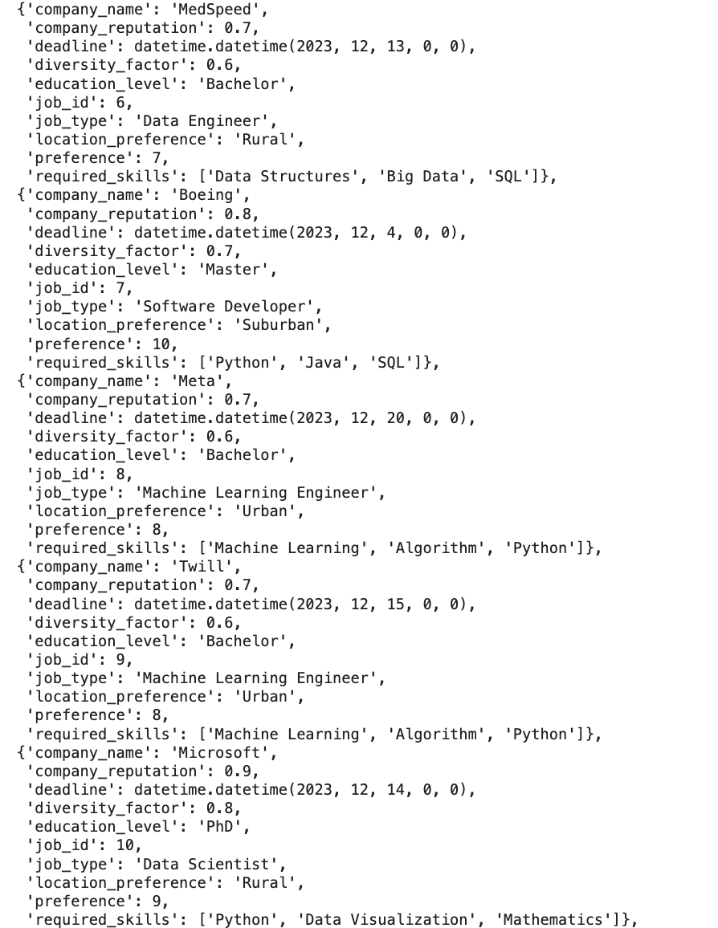
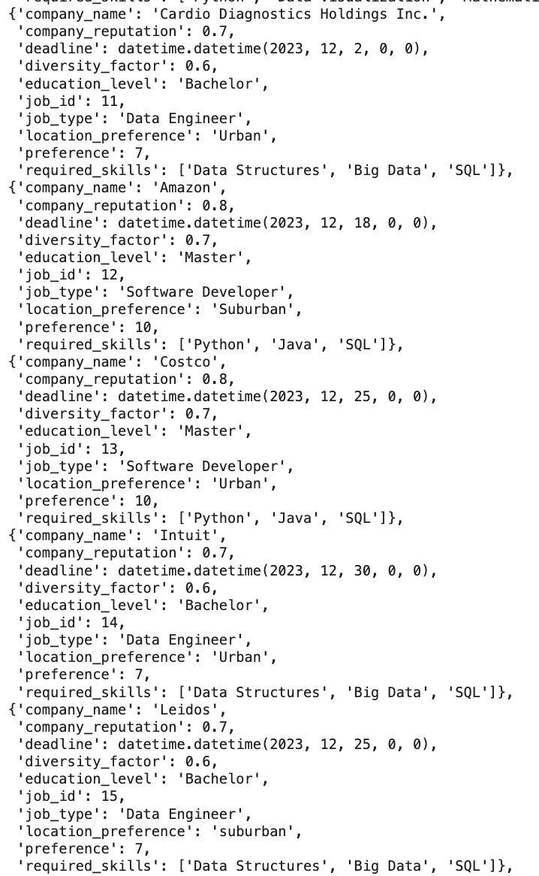
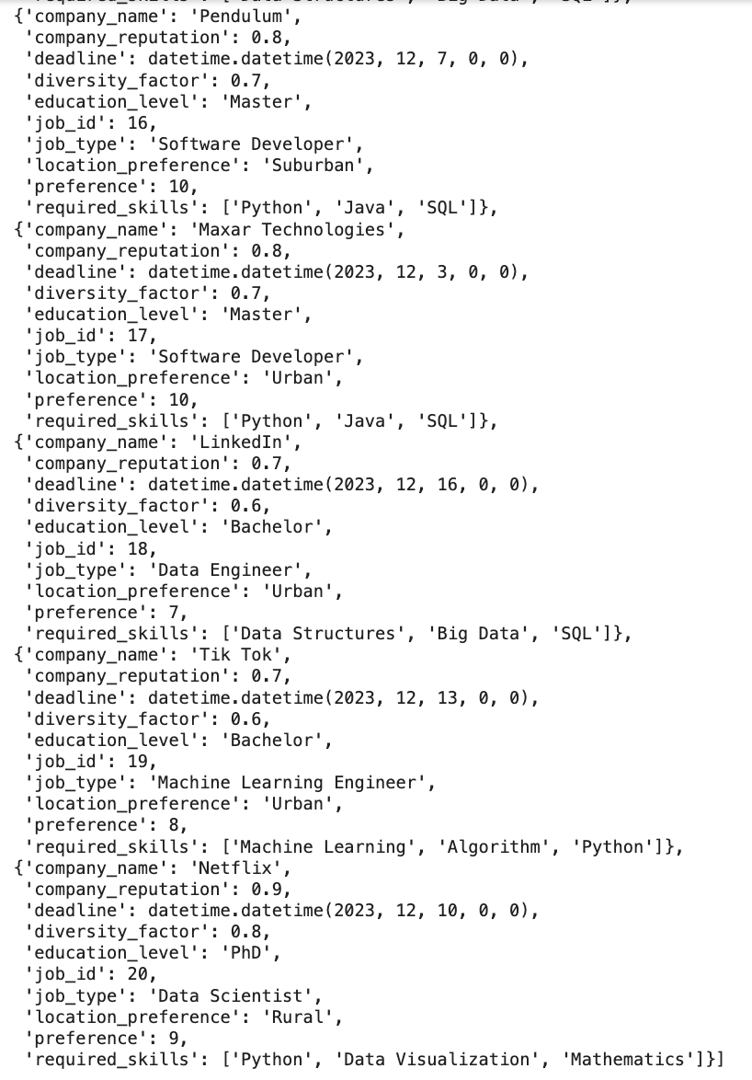
Inputs

Slide 7

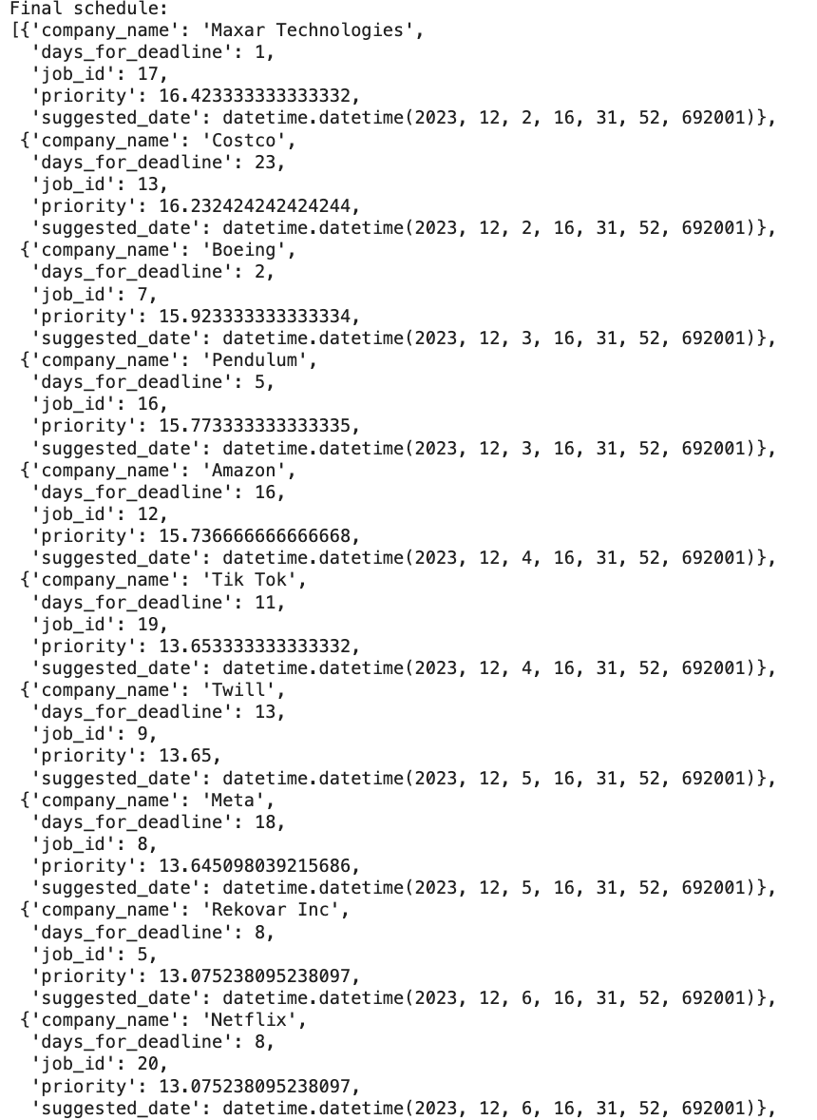
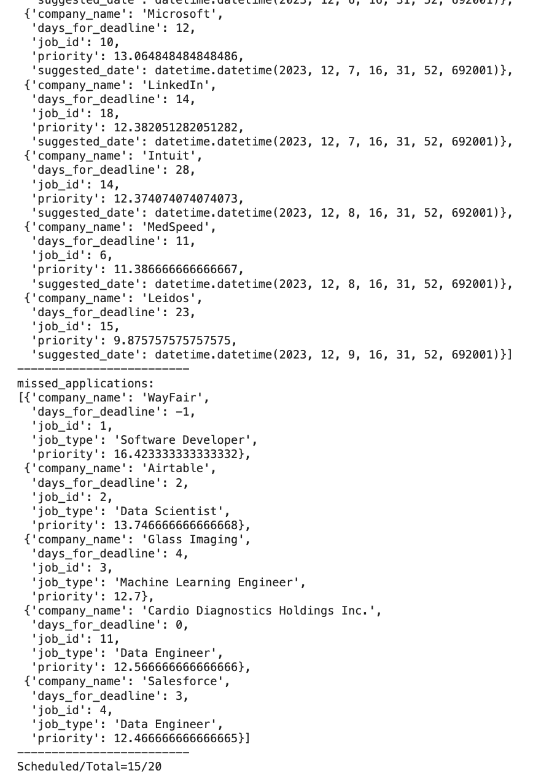
Results (Scheduled applications)

Slide 8
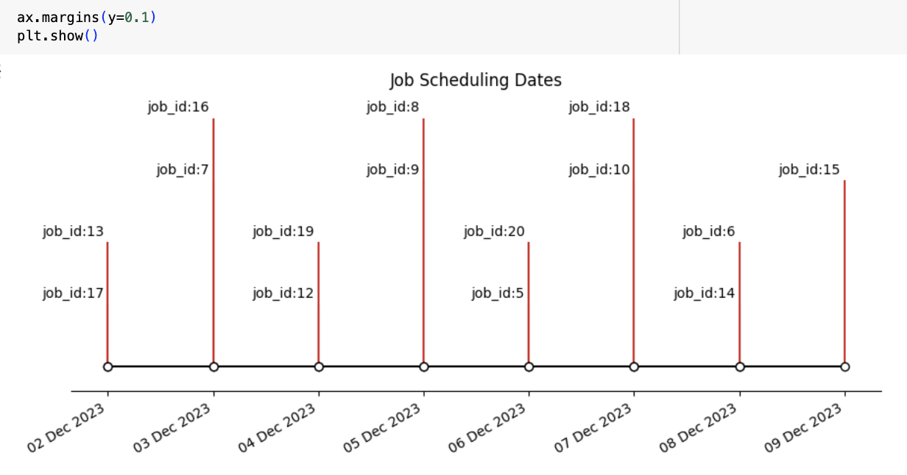
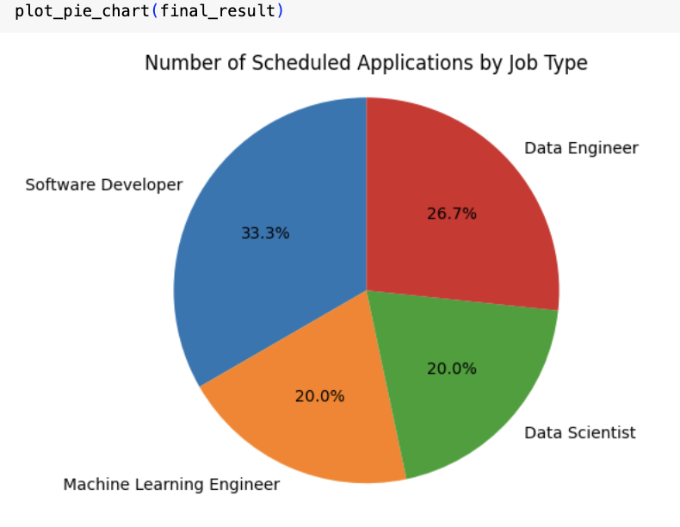
Results (Plots)

Slide 9
Analysis
Core Algorithms Used:
Priority Calculation: A weighted sum algorithm to calculate the priority of each job application.
Sorting: The sorted() function is used to prioritize job applications.
Scheduling: The algorithm schedules applications based on priority and deadlines.
Analysis :
Weighted Scoring Algorithm: A weighted scoring algorithm was employed that factored in deadline proximity, user preferences, and skills match. This method ensures a nuanced evaluation of each job application, considering both temporal constraints and qualitative criteria.
Efficient Sorting Mechanism: Applications are systematically sorted based on calculated priorities, streamlining the selection process. This approach optimizes decision-making by prioritizing applications that closely align with user preferences and skill sets.
Sophisticated Scheduling Algorithm: A sophisticated scheduling algorithm is implemented to manage deadlines and prevent conflicts in the application schedule. The user decides the number of applications that they can apply per day as threshold. This maximizing the likelihood of meeting deadlines while avoiding scheduling clashes.
Complexity Analysis:
Time complexity : O(m*log(m))
Space complexity : O(m)
m: Number of job applications,

Slide 10


Slide 11
Conclusion
Our project has effectively tackled the intricate challenge of optimizing the job application process by introducing a sophisticated priority-based scheduling approach.
The integration of weighted scoring algorithm demonstrated remarkable efficiency to handle a substantial volume of applications.
The project holds great promise for further evolution. Including integration with tracking tools and the refinement of Natural Language Processing algorithms.
The success of this project lies not only in its technical achievements but also in its potential to empower individuals in navigating the competitive landscape of job applications with precision and ease.

